Slide 1
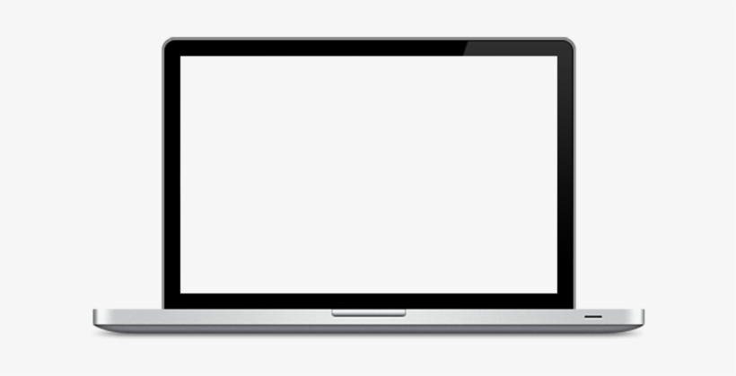
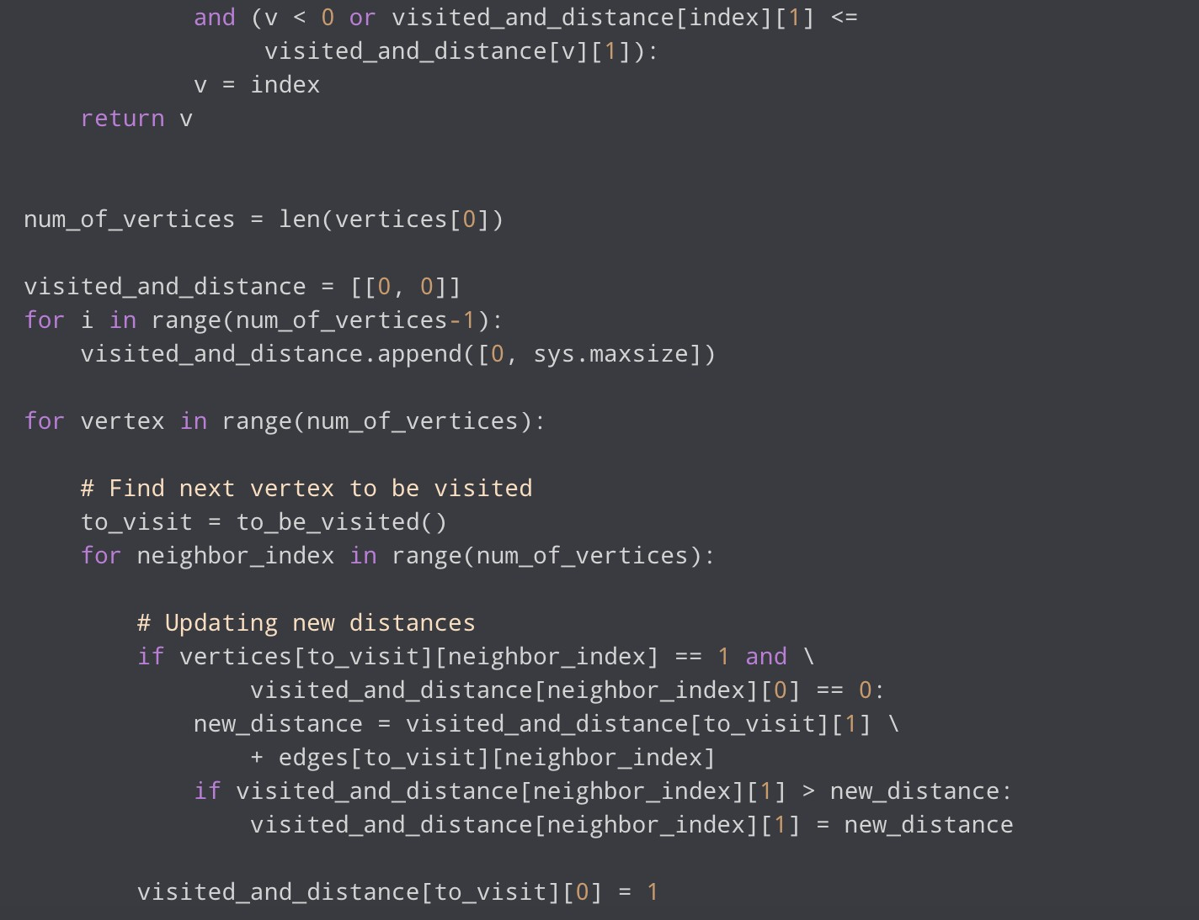
Operating systems – Final Project
Student:
Egamberdieva Lobar
File structure, File systems, Directories, File allocation.
Teacher: Prof. Ofer Wald

Slide 2



Introduction
File systems are categorized differently, and this list covers both common types like "NTFS," "FAT," "HFS+," "Extfs," "Ext2," "ReiserFS," "XFS," "HPFS," "ext2," "OpenBSD," "UDF," and "YAFFS," to say nothing of many other varieties that are not covered here.
01

Slide 3

File System
“File system” various data are assigned, stored, and retrieved on and from storage in computing and other devices that are made with digital data in mind using a file system, which is a form of organizational structure. File system parameters set the maximum size for files and partitions, control access priorities, manage file encryption, assign file attributes, and reroute operating system requests to locations where the relevant data is stored. They also predetermine the format of the contents and arrange it so that it is easily understood by the operating system as a set of files and directories.
02

Slide 4
File System
The largest operating system for computer devices, "Windows," is made to work with different file systems (including "NTFS" and "FAT"), however in comparison to other file systems, "NTFS" supports greater file and volume sizes and provides more effective methods of data organization.Despite sharing similar objectives, the "NTFS" and "FAT" file systems differ in how they handle file attributes as well as how they organize and store data. We'll go into more detail about specific file systems down below.
02

Slide 5
File systems
File Allocation Table is referred to as "FAT" in abbreviations. This is a basic, traditional file system that was initially created for tiny disks and straightforward folder configurations. In other words, the "FAT" file system uses a group-type of structure, with the file allocation table being a distinct logical area that is located at the volume's start. Two copies of the table are retained in case one becomes damaged, protecting the volume from unintentional mistakes that could impede proper table presentation.
03

Slide 6
File systems
The default file system for the majority of detachable drives is "FAT32," a more recent standard created to replace earlier ones like "FAT," "FAT12," and "FAT16." The space in "FAT32" is logically divided into four sections: a reserved area, a FAT region, a region for the root directory, and a data region for the storage of file contents. As long as they include a "USB" connector, this file system enables the use of FAT32 storage devices with both more recent PC models and more traditional computers or gaming consoles.
03

Slide 7
File systems
But, "FAT32" has several system restrictions. The maximum size of a file on a "FAT32" drive is 4 GB. Moreover, no more than 8 TB should be used for the full "FAT32" partition. Despite all of its quirks, "FAT32" is thought to be a good option for "USB drives" or external hard disks. It's preferable to think about a more sophisticated file system instead because «FAT32» lacks some capabilities that are critical for an internal disk, especially if you want to install the most recent version of the operating system, «Windows 10».
03

Slide 8
I
File systems
Extended File Allocation Table, or "exFAT," is the name of a file system. This standard is an upgraded version of Microsoft's "FAT32." By its core features, "exFAT" is fairly similar to "FAT32," but the biggest distinction is that "exFAT" does not have the restrictions that came with "FAT32," allowing users to store files up to 4 GB in size without any problems.Moreover, "exFAT" has fewer overwrite occurrences for sectors that actually store data, which is crucial for flash drives because memory cells will eventually wear down after a certain number of write operations. This file system also has a better allocation process for free space.
04

Slide 9
File systems
I
The "NTFS" file system was created in order to overcome the drawbacks and restrictions of the "FAT" family of file systems, enhance disk utilization performance, dependability, and efficiency, and build a trustworthy method for data storage and protection. The so-called "Encryption File System," which uses "user-transparent encryption" to safeguard data, is used by "NTFS" to store file data in its "Master File Table" (or "MFT") and implement varying levels of access to data for different users.
04

Slide 10
Difference
I
What separates the file systems "NTFS," "FAT," "FAT32," and "exFAT"Originally, the "FAT" file system handled files up to 4 GB in size and was intended for small-capacity storage devices, however "NTFS" increased the file size limit to an astonishing 16 TB. See more specific distinctions below
04

Slide 11
I
«NTFS»
Support for files and disks with a bigger capacity than what is supported by conventional file systems.
Assistance with long file names and foreign characters from challenging languages.
Severe drop in system performance while using "chkdsk" to inspect the internal or external hard disk.
The common system maintenance program "chkdsk" is infamous for being slow.
Increased security thanks to the new feature for file encryption.
Operation that is significantly faster on disks under 40 GB.
Smaller groupings of files.
To save disk space, compression is supported at the file system level for files, directories, and volumes.
File and folder user permissions.If the interrupted cluster is cleansed, file copies are considered "undone.“
The Master File Table at the start of the drive is where little files are maintained.
04

Slide 12
I
«FAT»
Hard disks from 32 MB to 2 TB are supported, although it is incompatible with the most recent version of "Windows.“
More potent and effective recovery tools.assistance with rapid "chkdsk" operations.
Simplified operating system allocation and a faster mechanism for reading files.
faster functioning on disks with a capacity under 10 GB.
Damaged flags are applied to cluster chains that contain data from interrupted copies.
The Master File table is distinct from the other files.
05

Slide 13
I
«FAT 32»It lacks the security protections found in the more recent "NTFS" file system.Also, it disallows the installation of the most recent version of "Windows" (due to the file's size and the fact that it can only be installed on "NTFS"-formatted disks).
05

Slide 14
I
«exFAT»By installing the necessary software, "exFAT" disks can be accessible under the "Linux" operating system.works with all Windows versions and current Mac OS X versions.
05

Slide 15
Conclusion
You can read this comparative review based on the specifications for storage devices to find out more about the unique characteristics of various file systems and select the best option for each individual device. If you want to use the storage with a variety of computing devices, you can leave the initially configured file system alone. However, if you want to use the storage as the system drive after installing "Windows 10," you can upgrade to the best file system, "NTFS."

Slide 16
The links for source code
https://github.com/LobarD/FileManager

Slide 17
E n d o f p r o j e c t . T h a n k y o u f o r a t t e n t i o n !

